Slide 1
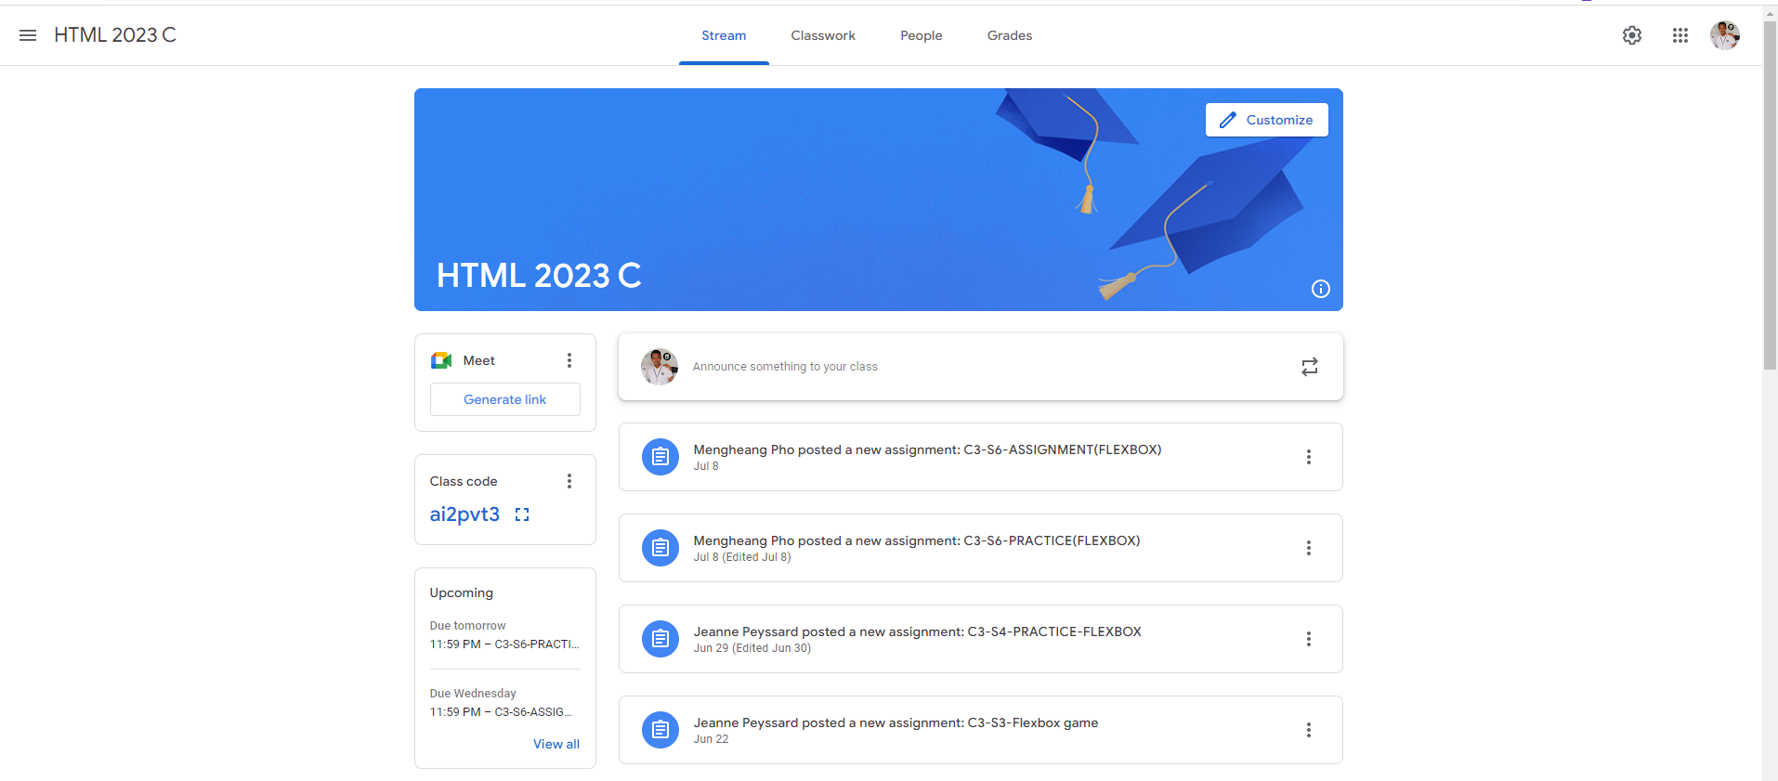
Identify root components of website below

Slide 2
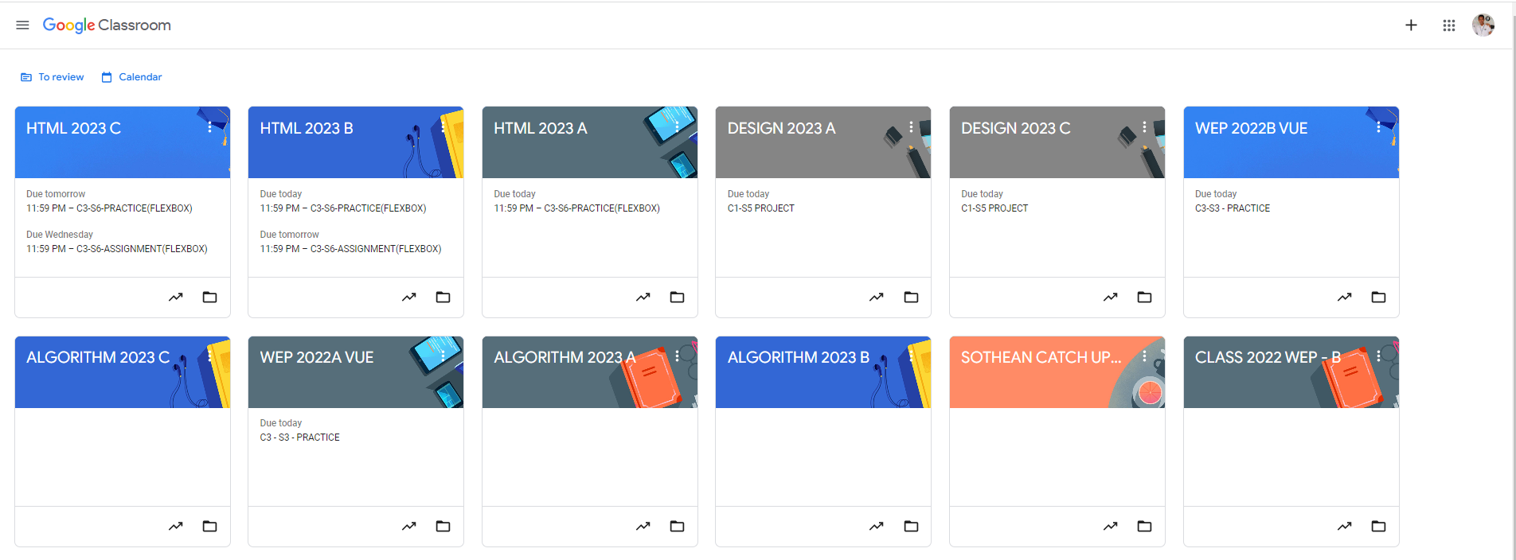
Root div
- Height: 100vh
content
nav
Flex: 0
header
Flex: 0
Flex: 1

Slide 3

Explanation:
div: header
div: content
First, split the page into two main divs. These will act as parent divs that contain smaller sections inside them.

Slide 4
In div: header
div: title
div: menu
div: user
We should break down the header into smaller divs to arrange them as we want. If necessary, we can also split the main divs into additional smaller divs.

Slide 5
In div: content
padding
padding
div: classroom
padding
padding
div: classwork
div: meetings
div: assignments
In this div, the content is centered, and padding is applied to create the white space for the design. We then split this div into two smaller divs: "classroom" and "classwork." The "classwork" div is further divided into two more divs: "meetings" and "assignments“.

